Slide 1

The Battle of Neighborhoods Vancouver
Richard Balbuena

Slide 2
“Most of the world will make decisions by either guessing or using their gut. They will be either lucky or wrong.”
Suhail Doshi, chief executive officer, Mixpanel.

Slide 3
Introduction
Vancouver is a coastal seaport city in western Canada, located in the Lower Mainland region of British Columbia. As the most populous city in the province, the 2016 census recorded 631,486 people in the city, up from 603,502 in 2011. The Greater Vancouver area had a population of 2,463,431 in 2016, making it the third-largest metropolitan area in Canada. Vancouver has the highest population density in Canada, with over 5,400 people per square kilometre, which makes it the fifth-most densely populated city with over 250,000 residents in North America, behind New York City, Guadalajara, San Francisco, and Mexico City. Vancouver is one of the most ethnically and linguistically diverse cities in Canada: 52% of its residents are not native English speakers, 48.9% are native speakers of neither English nor French, and 50.6% of residents belong to visible minority groups. Vancouver is consistently named as one of the top five worldwide cities for livability and quality of life, and the Economist Intelligence Unit acknowledged it as the first city ranked among the top ten of the world's most well-living cities for ten consecutive years. In 2011, the city planned to become the greenest city in the world by 2020. Vancouverism is the city's urban planning design philosophy.

Slide 4
Background
Safety is the top concern when moving to a new area. If you don’t feel safe in your own home, you you’re not going to be able to enjoy living there.
Key Questions
A. What is the most common crime in Vancouver?
B. Which of the boroughs have the highest crime rates?
C. Which of the boroughs have the lowest crime rates?
D. Identify the top 10 venues in each neighborhood

Slide 5
Business Problem
This project aims to select the safest borough in Vancouver, BC Canada based on the total crime, explore the neighborhoods of that borough to find the 10 most common venues in each neighborhood and finally cluster the neighborhoods using K-Mean clustering.
Interest and stakeholders
Expats who are considering to relocate to Vancouver and Real States companies will be interested to identify the safest borough in Vancouver and explore its neighborhoods and common venues around each neighborhood

Slide 6
Data section
The data acquisition for this project is a combination of data from two sources:
• The first data source of the project uses Vancouver crime data. This dataset contains the Vancouver Police Department's crime records from 2013 to 2019. It can be found at: https://vancouver.ca/police/organization/planning-research-audit/stats-crime-rate.html
• Foursquare API as its prime data gathering source as it has a database of more than 105 million places, especially their places API which provides the ability to perform location search, location sharing and details about a business. Photos, tips and reviews jolted by Foursquare users can also be used in many productive ways to add value to the results.

Slide 7
Methodology
HTTP requests would be made to this Foursquare API server using postal codes of the Vancouver city neighborhoods to pull the location information (Latitude and Longitude).
Foursquare API search feature would be enabled to collect the nearby places of the neighborhoods.
Due to http request limitations the number of places per neighborhood parameter would reasonably be set to 100 and the radius parameter would be set to 700.

Slide 8
Methodology
Folium and Python visualization library would be used to visualize the neighborhoods cluster distribution of Vancouver city over an interactive leaflet map.
Extensive comparative analysis of two randomly picked neighborhoods world be carried out to derive the desirable insights from the outcomes using python’s scientific libraries Pandas, NumPy and Scikit-learn.
Unsupervised machine learning algorithm K-mean clustering would be applied to form the clusters of different categories of places residing in and around the neighborhoods. These clusters from each of those two chosen neighborhoods would be analyzed individually collectively and comparatively to derive the conclusions.

Slide 9
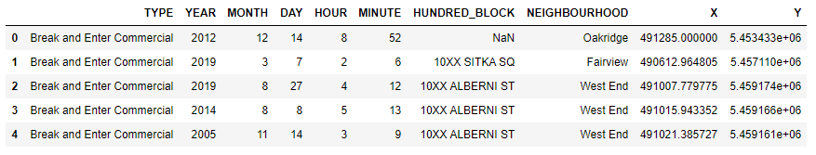
Methodology
Initial data exploration and summary.

Slide 10
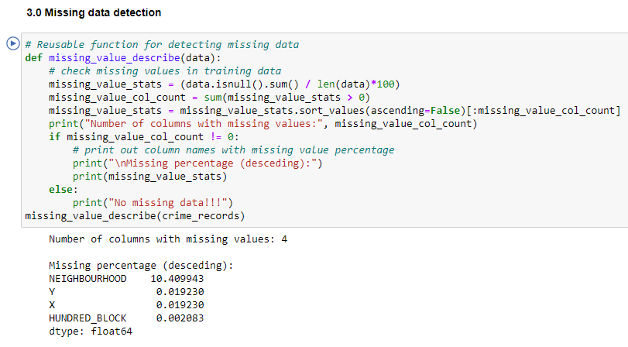
Missing data detection

Slide 11
Missing data detection
From the above missing data examination, we have 4 columns with missing data: they are NEIGHHOURHOOD (10.42% missing), MINUTE(10.02% missing), HOUR(10.02% missing), and HUNDRED_BLOCK(0.002% missing).
The missing percentage of MINUTE and HOUR columns are the same we are going to disregard the missing information. However, the HUNDRED_BLOCK, which is the physical address, has ~10% lower missing value than the NEIGHBOURHOOD column. The missing data is due to Statistics Canada definition of neighbourhoods within municipalities. Neighbourhoods within the City of Vancouver are based on the census tract (CT) concept within census metropolitan area (CMA). The missing NEIGHBOURHOOD columns might be caused by unlabeled neighbourhoods in the Statistics Canada dataset or they just aren't labeled. I am thinking about create a dictionary for each street-neighbourhood pair to predict the missing neighbourhood.

Slide 12
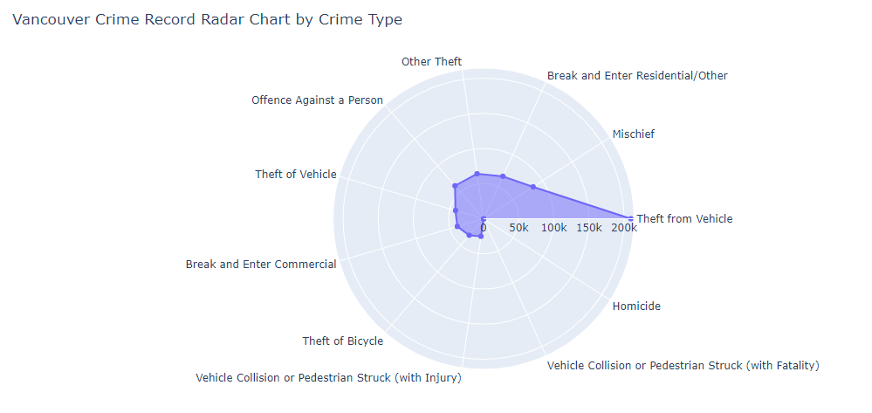
Distribution of each type of crime

Slide 13
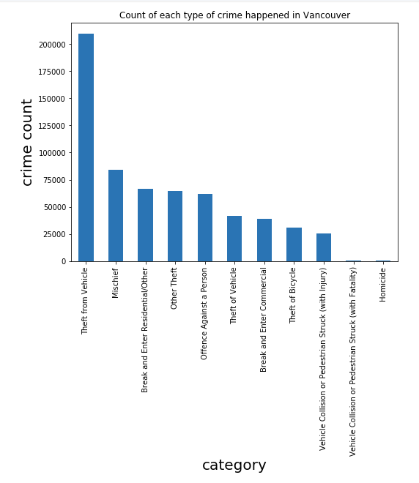
Distribution of each type of crime
It appears that the most common type of crime is associated with vehicle in Vancouver: Theft from Vehicle, Theft of Bicycle and Vehicle Collision. Since 2003, there are 209609 crime categorized as "Theft from Vehicle".

Slide 14
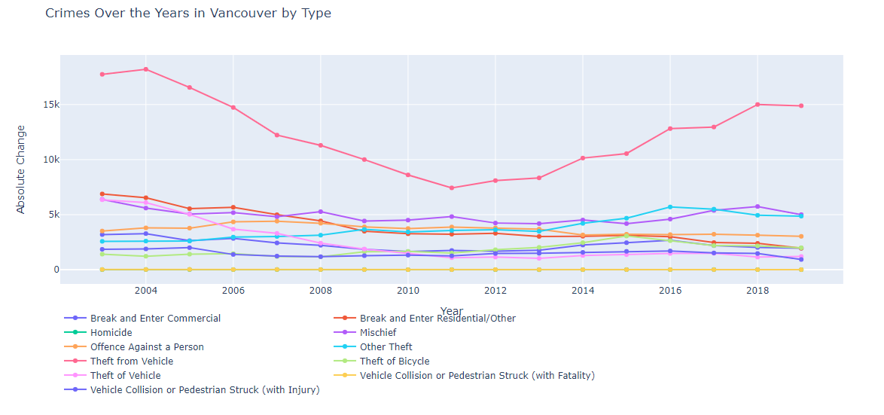
Change of crime over the years

Slide 15
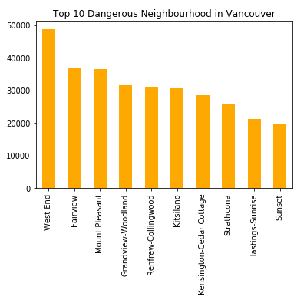
Top 10 most dangerous neighbourhood in Vancouver
It turns out the most crime populated neighbourhood is West End

Slide 16
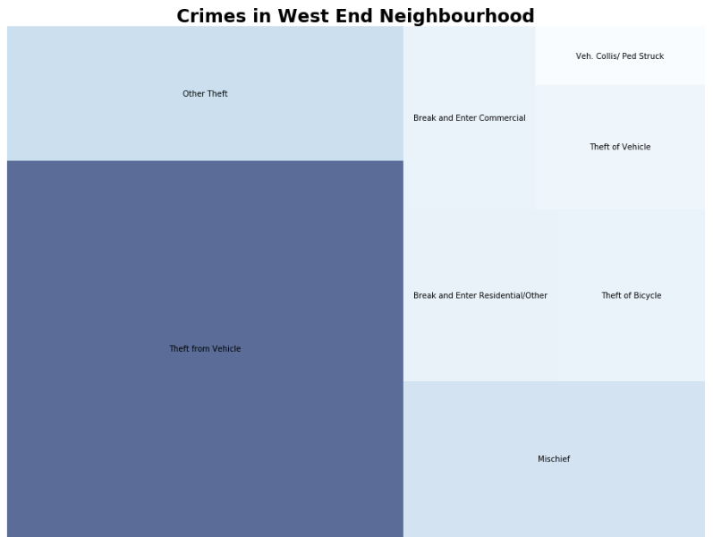
Crimes in West End

Slide 17
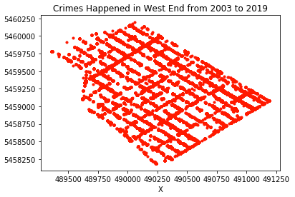
Crimes in West End
The scatter plot is actually the shape of the West End neighbourhood. Crimes happened on almost every street of West End from 2003 to 2019.

Slide 18
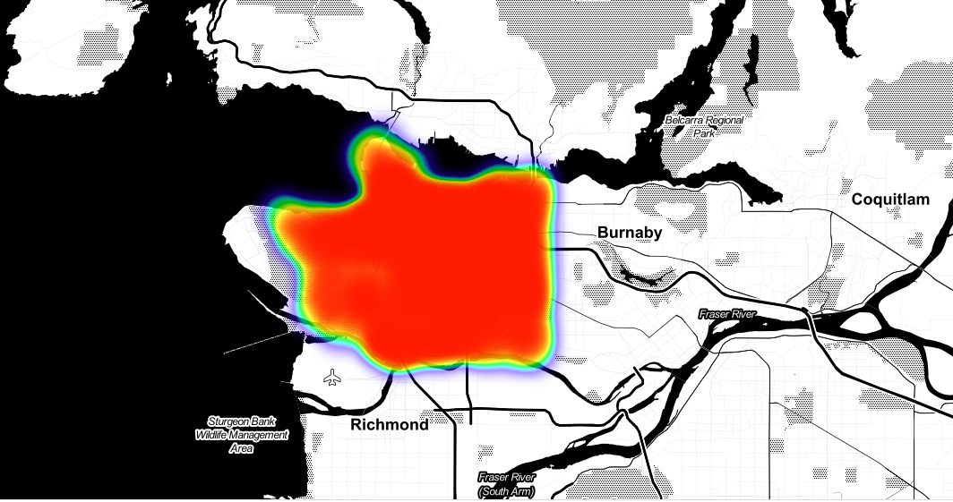
Crime Heatmap of 2019

Slide 19
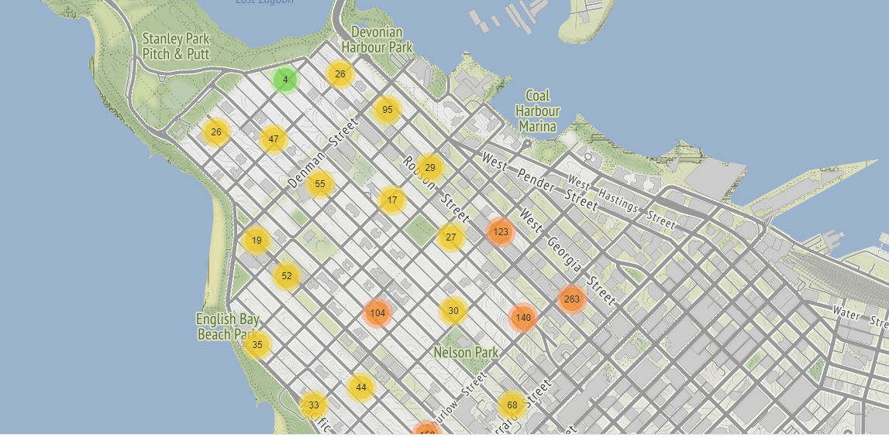
West End “Theft from Vehicle”

Slide 20
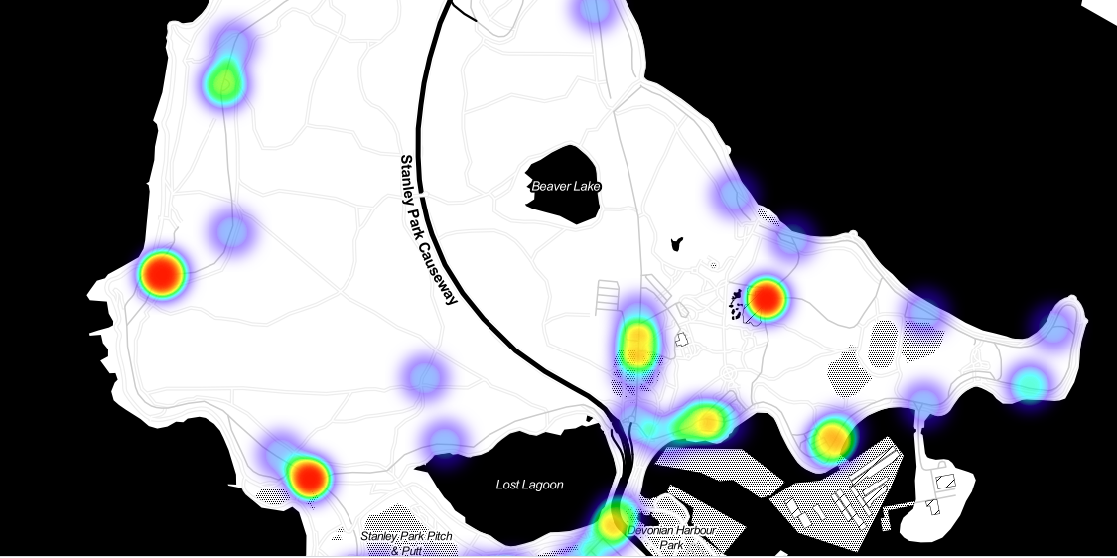
Crimes Happened in Stanley Park

Slide 21
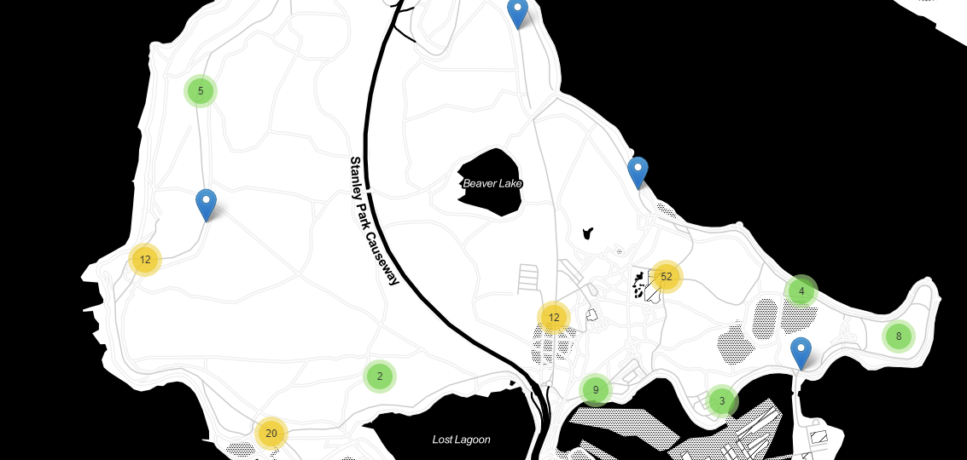
Crimes Happened in Stanley Park

Slide 22
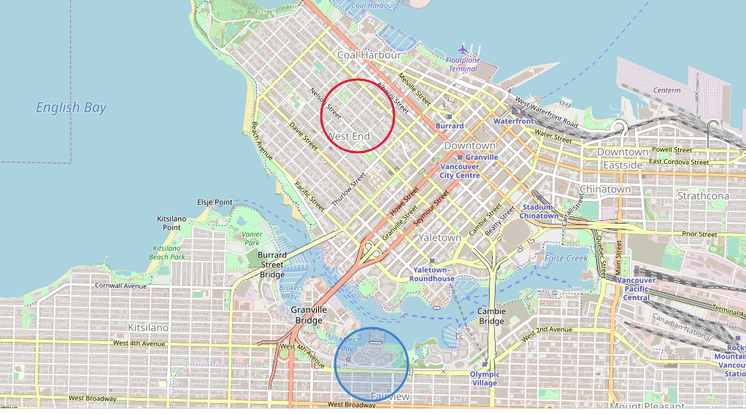
West End and Fairview

Slide 23
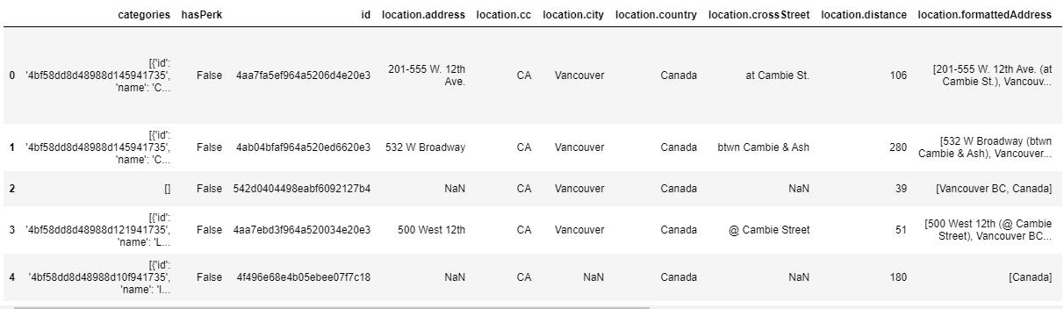
Exploring venues

Slide 24
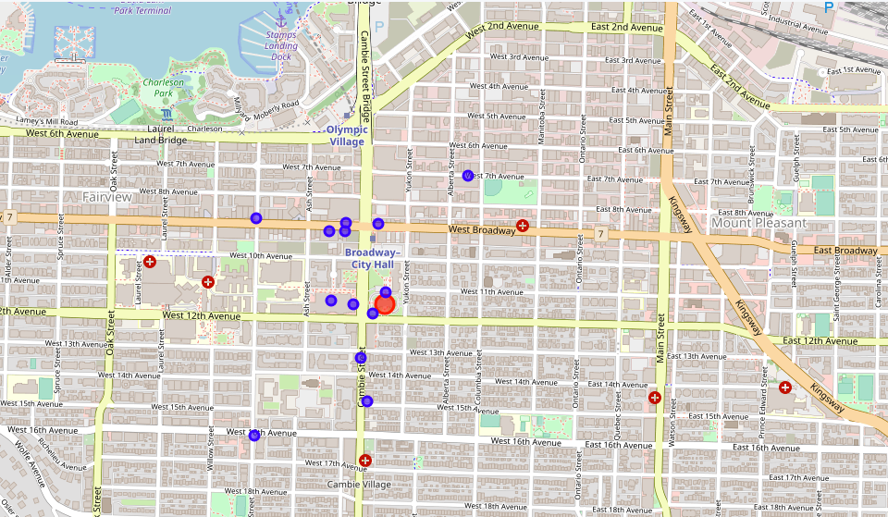
Fairview Top Venues

Slide 25
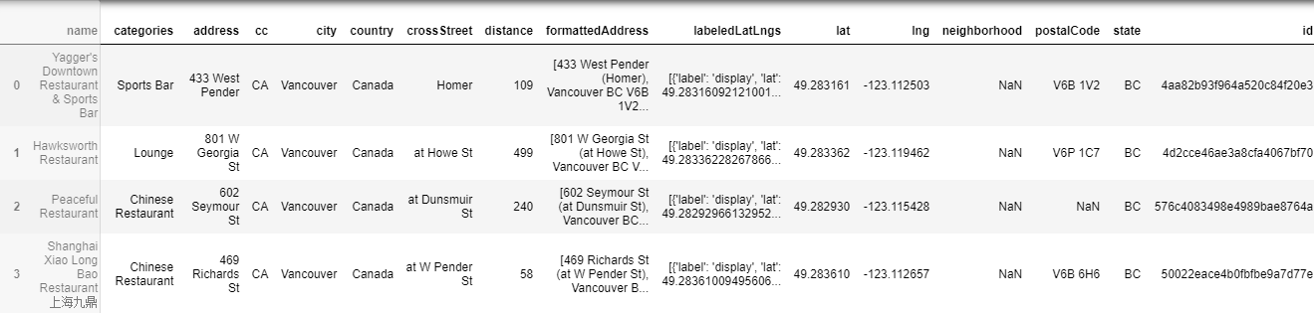
West End Top Venues

Slide 26
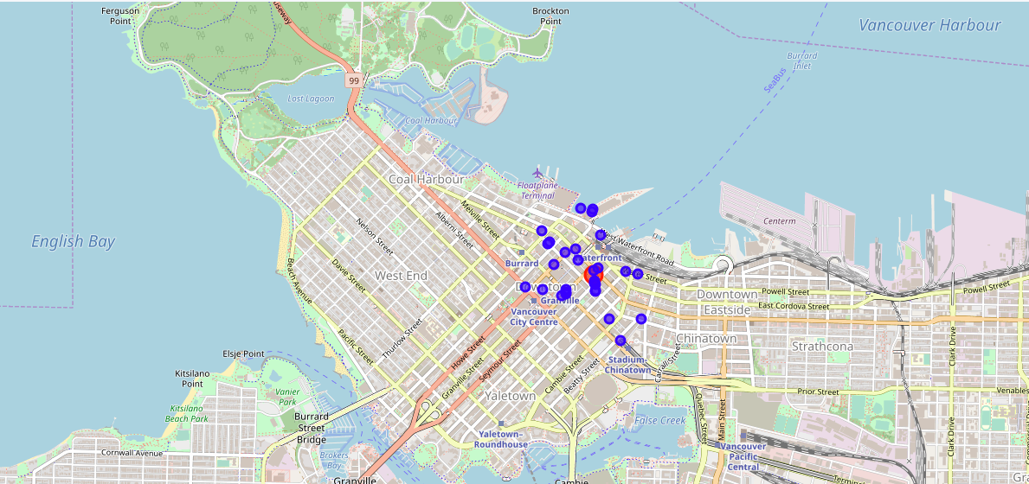
West End Venues Cluster

Slide 27
Discussion
The aim of this project is to help people who want to relocate to the safest borough in Vancouver, expats can chose the neighborhoods to which they want to relocate based on the most common venues in it. But most important is to chose a neighborhood with a relative high safety index like Hasting-Sunrise and Sunset.
Through this exploratory analysis of the Vancouver crime data:
I found that the most common crime in Vancouver is related to vehicle such "Theft of Vehicle", "Theft of Bicycle" and "Vehicle Collision". Definitely, watch out for your bikes, motorcycle, and cars.
West End neighbourhood remain the most crime populated area from 2003 to 2019. The location record of crimes committed in West End can be used to draw a clear street map of West End.
The occurrences of crimes are quite evenly distributed if crimes are counted by day or counted by month. However, crime occurs more in after work hours and midnight in Vancouver.

Slide 28
Conclusion
This project helps a person get a better understanding of the neighborhoods with respect to the most common venues in that neighborhood. It is always helpful to make use of technology to stay one step ahead for example in finding out more about places before moving into a neighborhood.
We have just taken safety as a primary concern to shortlist the safest neighborhood of Vancouver. The future of this project includes taking others factors such as cost of living in the areas into consideration to shortlist the borough, such as filtering areas based on a predefined budget. It will be interesting to includes demographic data to evaluate the population of the different neighborhoods.

